Slide 1
Neural Network Accelerator
Team 11
Kai Segimoto, Shang Wang

Slide 2



Importance of Neural Network Accelerator
Design Goals
As the demand for AI and machine learning grows, the need for faster, more efficient computing of models such as neural networks becomes increasingly important.
Neural Networks and machine learning have various edge applications such as real-time image classification, keyword spotting, or anomaly detection rely on fast, low-power inference under tight latency and energy constraints.
By implementing a neural networks on a hardware level including matrix multiplication and activation functions/quantization, performance factors such as latency, power consumption, and area can be greatly optimized.
Design an 8-bit 4×4 matrix multiplier engine (MAC-based systolic array) with a complete FSM-controlled datapath.
Implement separate SRAM blocks for weights and activations/bias, including row/column addressing, precharge, column mux, sense amp, and write driver behavior at the block level.
Implement Matrix multiplication using a systolic array architecture, which uses parallelism for highly increased throughput
Add an activation stage (ReLU) + int8 normalization, then store results in an output memory with serial I/O interface support.
Verify functionality with RTL + testbenches, then complete synthesis and physical flow (Cadence liberate characterization, Genus synthesis, Innovus P&R)

Slide 3
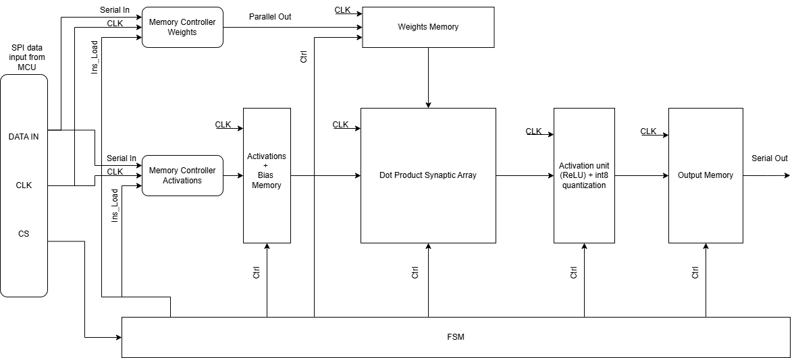
Block Diagram

Slide 4
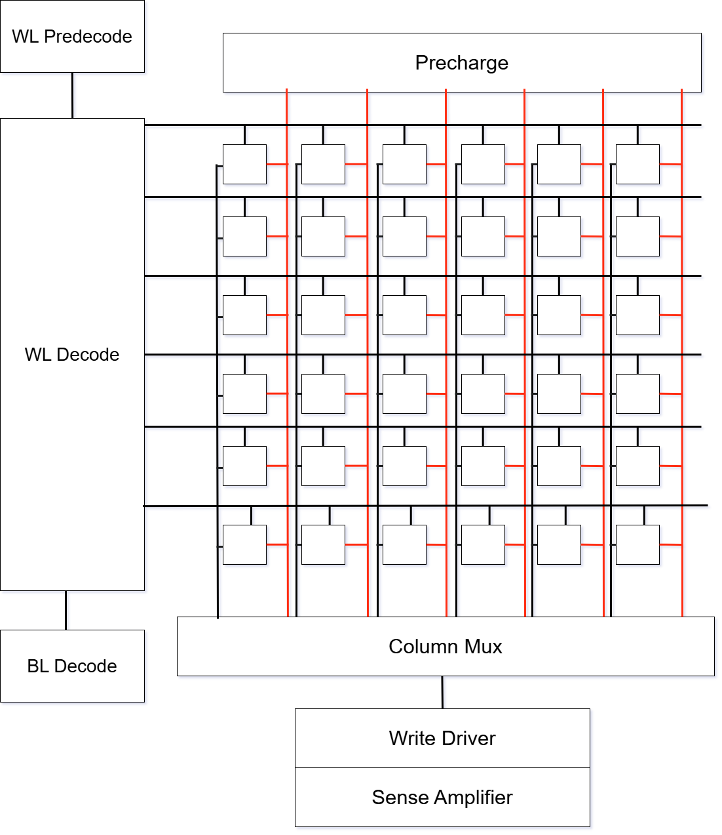
Memory Array Operation
Each block is an 8 bit SRAM
The controller receives row_addr[2:0], col_addr[2:0], and read/write control signals from FSM.
Before every read access, the precharge circuit equalizes and precharges each BL/BLB pair to a known level.
The WL predecode stage converts the row address into intermediate decode signals
The WL decode asserts exactly one wordline, enabling all cells in the selected row to connect to their BL/BLB pairs.
The sense amplifier resolves and amplifies the BL/BLB differential to produce a stable digital output word.
After the operation, the wordline is deasserted and the array returns to the precharge state for the next access.
BL BLB
SRAM
row_addr[2:0]
col_addr[2:0]

Slide 5
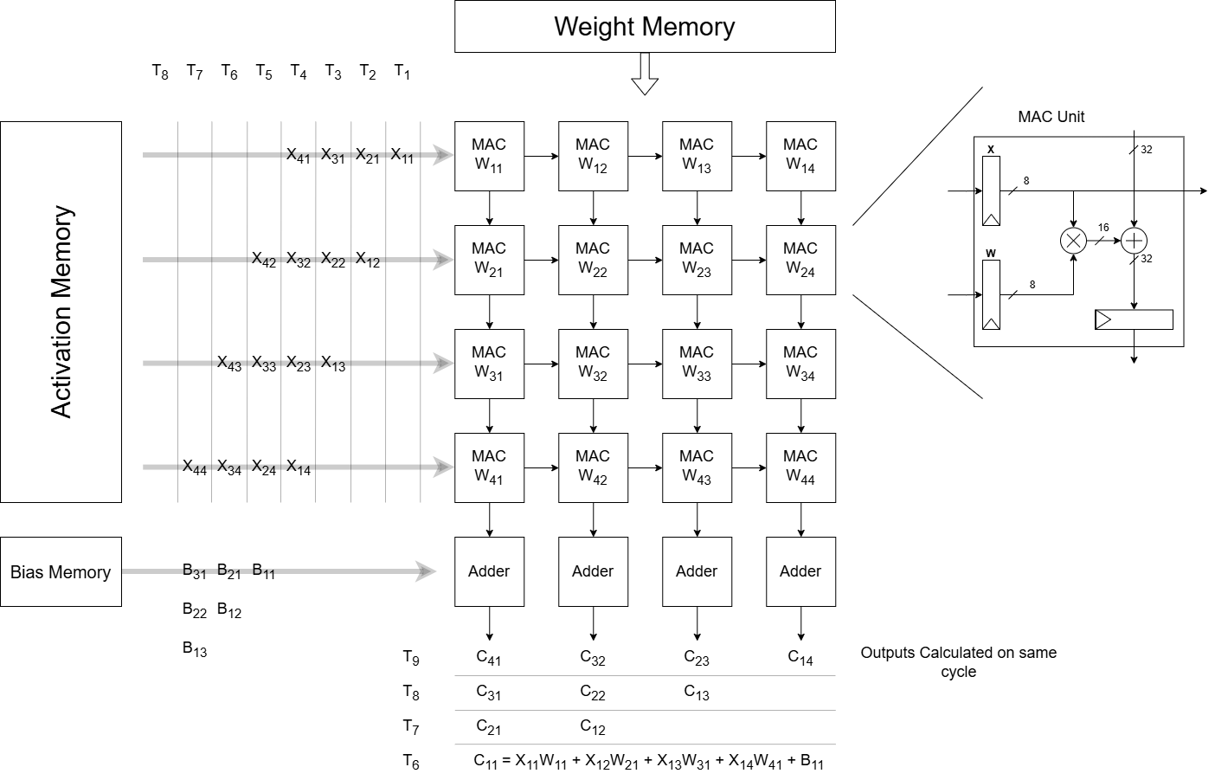

Dot Product Systolic Array Operation
If using 32 bits use this image
Dot product will be performed using a Systolic Array architecture for high efficiency data flow
Weights are loaded into each MAC unit before computation
Input activations flow to the right and partial sums flow down each clock cycle for data reuse and parallelism
Increased throughput compared to individual cell calculations
Inputs will be controlled by external control logic block

Slide 6
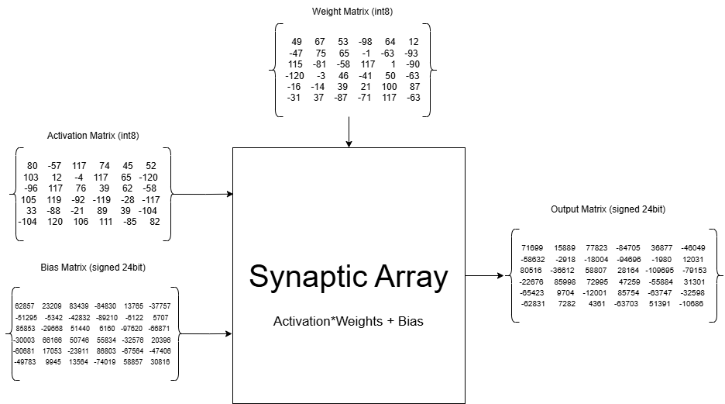
Dot product Simulation
Script implementing systolic array timing and flow created in matlab
Functionality is verified as output is correct

Slide 7
Timeline
Task | Start Date | End Date | Assigned to | Description
Design Confirmation | 2.11 | 2.15 | Both | Determine overall architecture,design specifications,and performance goals before starting
Verilog Coding and Simulation for Memory Array | 2.15 | 2.20 | Shang | Implement the memory controller RTL, write a testbench, and run simulation to verify control/timing via waveforms
Verilog Coding and Simulation for Memory Controller | 2.21 | 2.28 | Shang | Implement the memory array RTL, write a testbench, and run simulation to verify correctness
Verilog Coding and Simulation for Matrix multiplier | 2.15 | 2.22 | Kai | Implement the matrix multiplier RTL, write a testbench, and simulate to validate outputs and latency against theoretical value
Verilog Coding and Simulation for Activation unit | 2.23 | 2.28 | Kai | Implement the activation RTL, write a testbench, and simulate to verify mapping and overflow behavior
Verilog Coding and Simulation for FSM | 3.1 | 3.9 | Both | Implement the top-level FSM to coordinate modules, write an integration testbench, and simulate to verify end-to-end sequencing and state transitions.

Slide 8
Task | Start Date | End Date | Assigned to | Description
Verilog Coding and Simulation for Top Level Integration | 3.10 | 3.16 | Both | Integrate all RTL modules at the top level, connect interfaces, and run simulations to confirm signal connectivity and control flow.
Create SRAM Macro. Schematic + Layout | 3.12 | 3.25 | Kai | Create SRAM macro to be used for verilog code, generate .lib and .lef files.
Make and characterize standard cell library in Cadence | 3.17 | 3.25 | Shang | Create the standard cells and characterize them using Cadence Liberate to generate .lib models.
Synthesize verilog, port to Cadence | 3.26 | 4.3 | Both | Set up and run synthesis to produce the gate-level netlist and required library/PDK files for the Cadence digital flow.
Run and verify Innovus flow layout. Import DEF file into virtuoso. Fix DRC, LVS | 4.4 | 4.12 | Both | fix DRC/LVS: Run Innovus P&R, check timing/DRC/LVS, export DEF, import into Virtuoso, and resolve DRC/LVS/antenna issues.
Final Confirmation and Tape Out | 4.13 | 4.20 | Both | Perform clean DRC/LVS and required post-layout checks and generate the final deliverables for tape-out submission.

